Slide 1
Big Data Guys
Comprised of: Aaron Dies, Dean Burg, Clay Beal, Ian McCourt

Slide 2
Spotify Playlist Analyzer - A High Level Description
Web-hosted playlist analyzer
Genre and Mood Metrics
Ability to Login
Ability to Paste Link
Charts to Display Analysis
Pie chart for genres
Bar charts for mood metrics

Slide 3
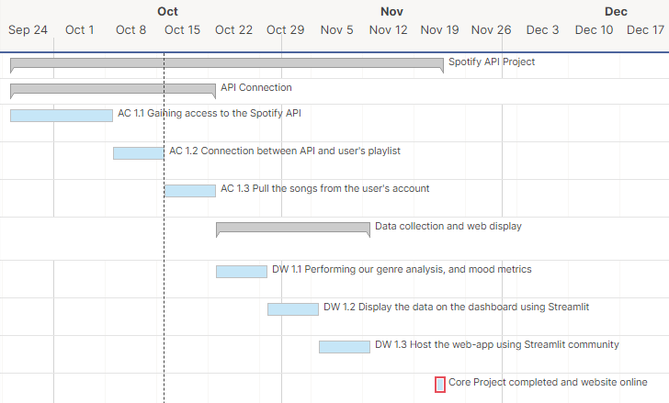
Gantt Chart

Slide 4
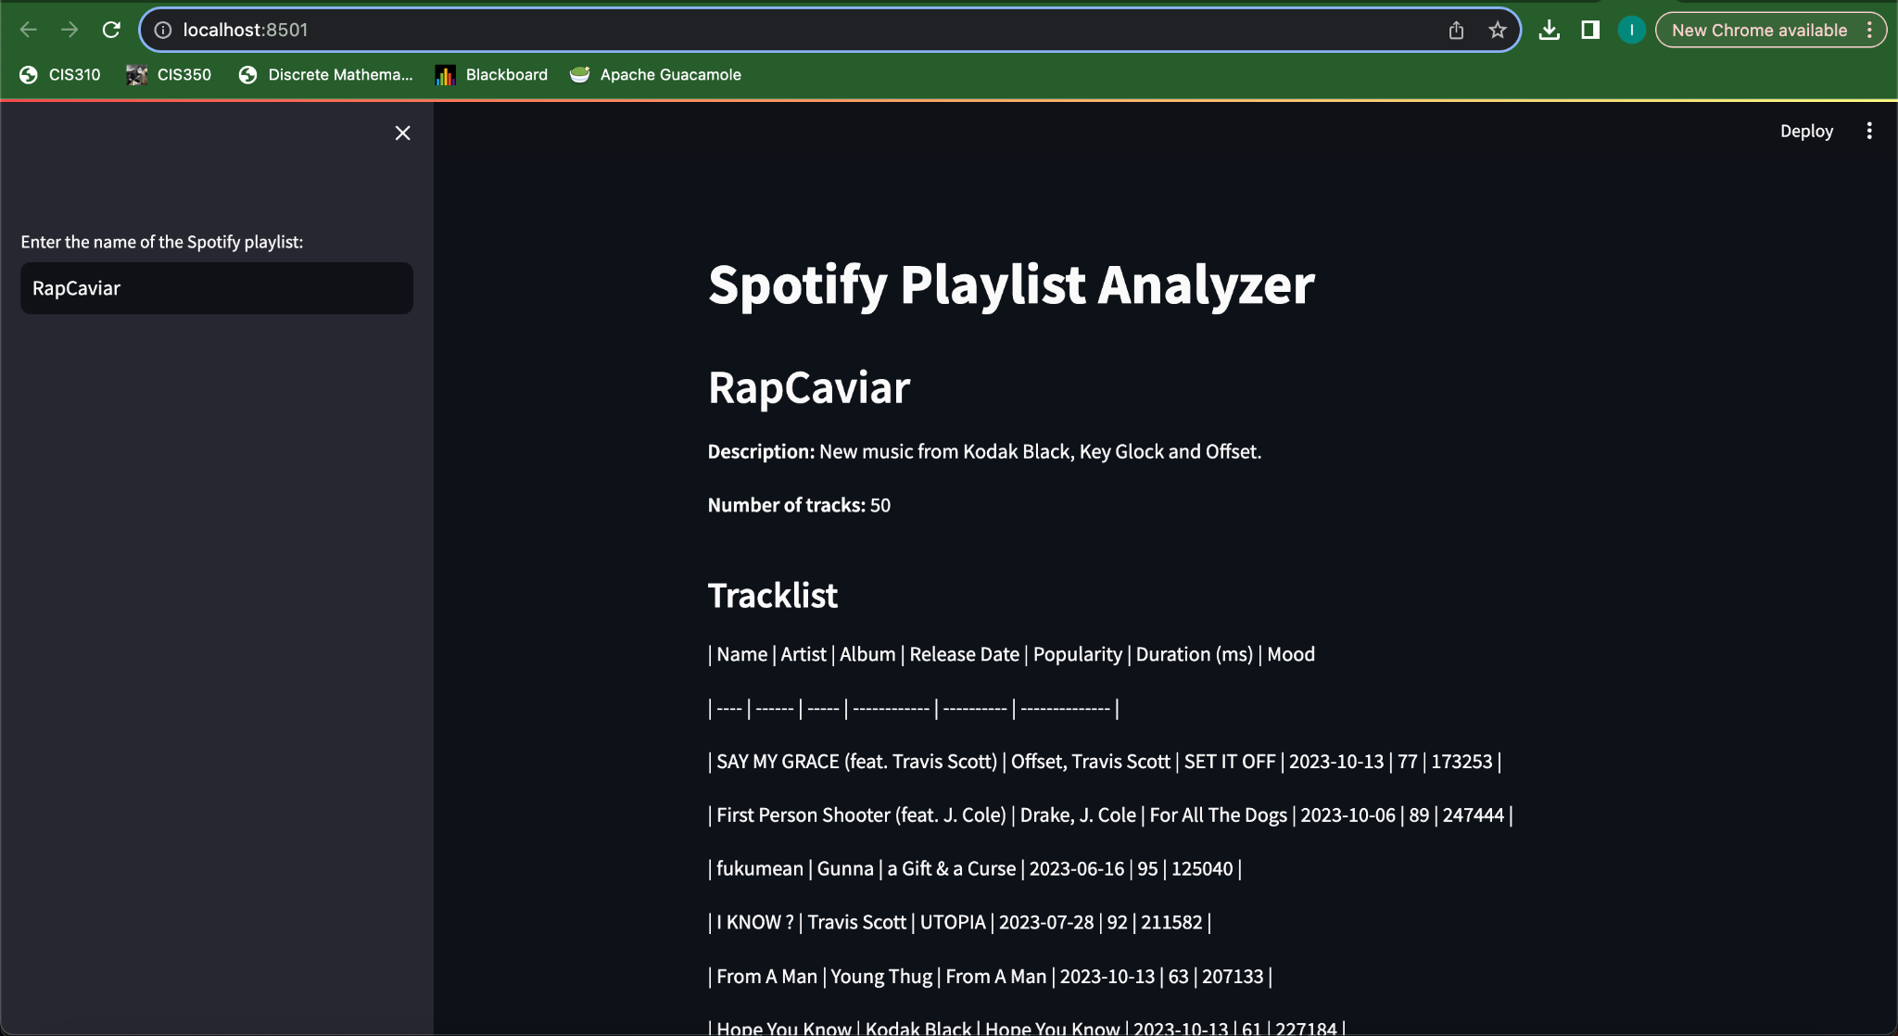

Slide 5
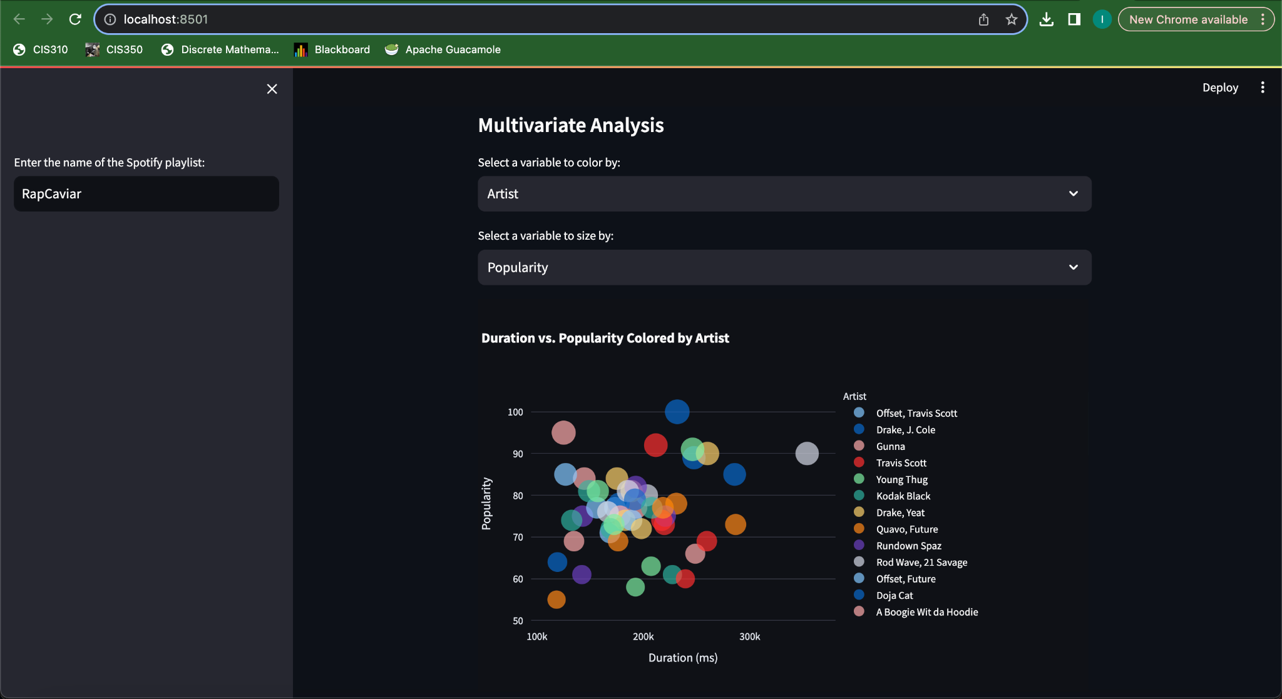

Slide 6
Tasks Remaining
Connect user items
Pull user songs
Perform genre analysis and mood metrics
Display the metrics on dashboard
Host on an accessible website

